Slide 1
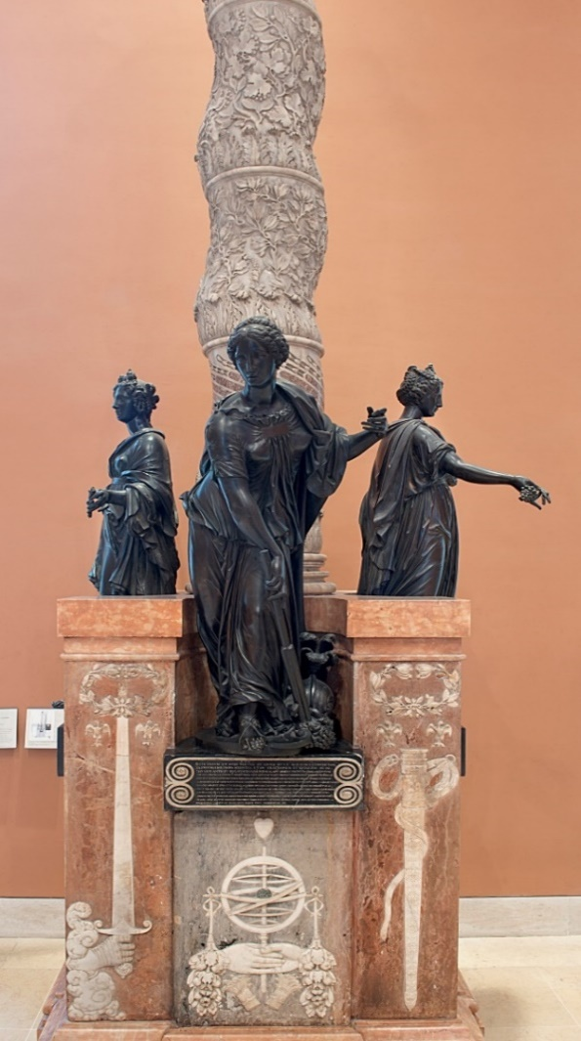
Case Study 5: One commission, two sculptors, how many founders? Technical study of three Renaissance statues from the monument of the heart of Duke Anne de Montmorency
The Monument of the Heart of Duke Anne de Montmorency (1493-1567), Constable of France commissioned in 1571 includes three life-size bronze statues. These were made by two sculptors, Barthélémy Prieur and Martin Lefort. In the archives, only one founder, Nicolas Péron, is associated with the casting of two of the statues. A technical investigation of the statues, including metal and core analysis and visual and radiographic examinations, was undertaken to discern whether all three statues might have been cast by Péron and to shed light on the relationship between sculptors and founder(s), crucial in this period of renaissance bronze statuary.
Fig 574
Main questions
Synopsis of technical parameters
Further questions
Further Resources
Intro and context
Visual evidence
Lasagna
Alloys
Summary of findings...
Direct cast?
Armature
Core
Chaplets

Slide 2

The Commission:
In 1571, Madeleine of Savoy, wife of Anne de Montmorency, Constable of France, commissioned the architect Jean Bullant (1515-1578) to produce a funerary monument for the heart of her husband. The monument, now in the Louvre Museum, is composed of a sculpted stone column that would originally have been topped by an urn containing the heart. Three bronze, allegorical personifications of abundance, Peace and Justice were place around the base of the column as witnesses to the character of the deceased.
Bullant charged two sculptors to produce the statues. Barthélémy Prieur (1536-1611) was responsible for the figures of Abundance and Peace. Martin Le Fort (known to have been active between 1562-1582) made that of Justice. The founder Nicolas Péron was commissioned to cast the two statues by Prieur. There is no record of who cast the third.
Fig 574
Main questions
Synopsis of technical parameters
Further questions
Further Resources
Intro and context
Visual evidence
Lasagna
Alloys
Summary of findings...
Direct cast?
Armature
Core
Chaplets

Slide 3
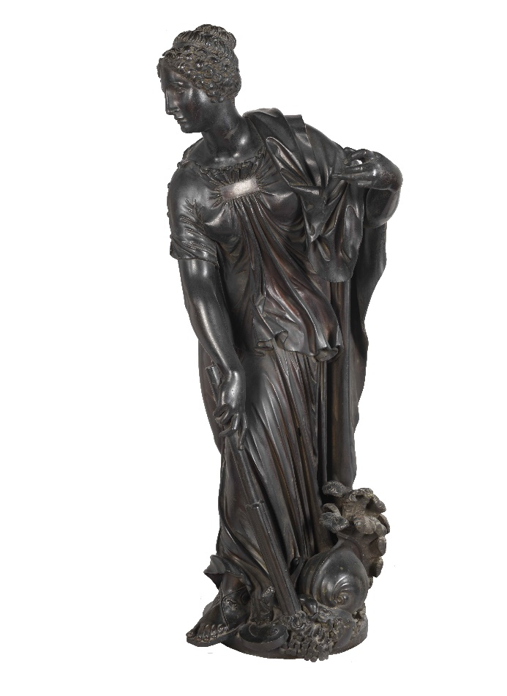
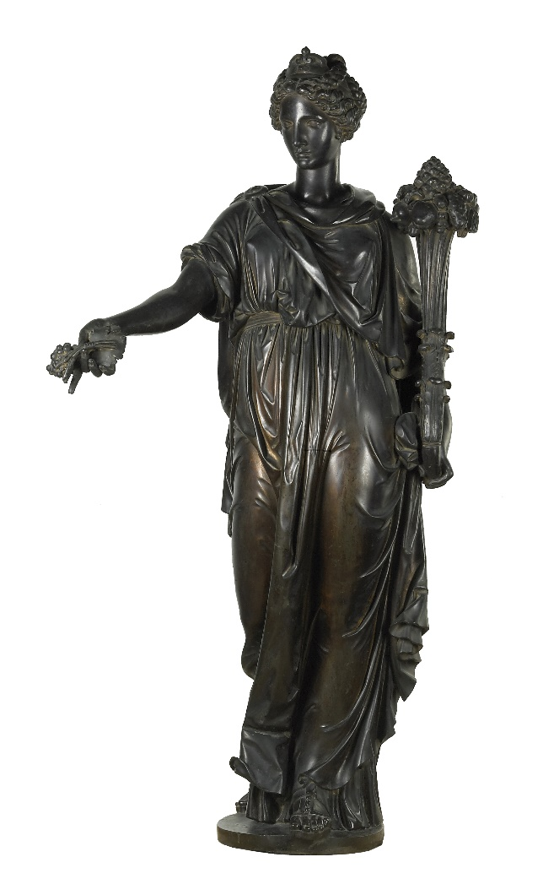
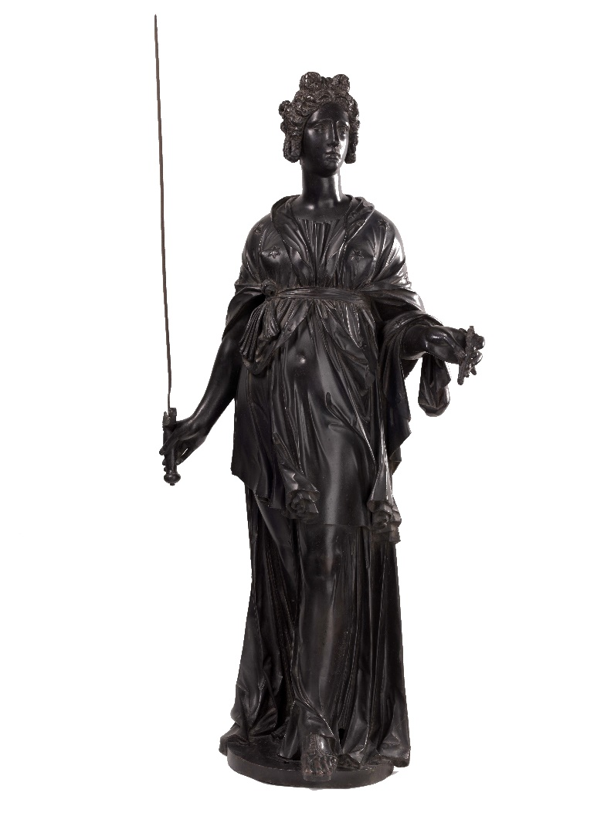
Principal Questions:
Fig 541
Fig 6
Fig 545
Can the physical evidence help clarify who was ultimately in charge of the production, and whether they were all cast by the same founder?
Can comparison of the casting process used for each of the statues help answer these questions?
And likewise, what can the characterization and comparison of the materials used tell us with regard to these questions?
Peace, 1571, Barthélémy Prieur, 128cm
© C2RMF A Maigret
Abundance, 1571, Barthélémy Prieur, 128cm
© C2RMF A Maigret
Justice, 1571, Martin Le Fort, 128cm
© C2RMF A Lambert J Marsac
Main questions
Synopsis of technical parameters
Further questions
Further Resources
Intro and context
Visual evidence
Lasagna
Alloys
Summary of findings...
Direct cast?
Armature
Core
Chaplets

Slide 4
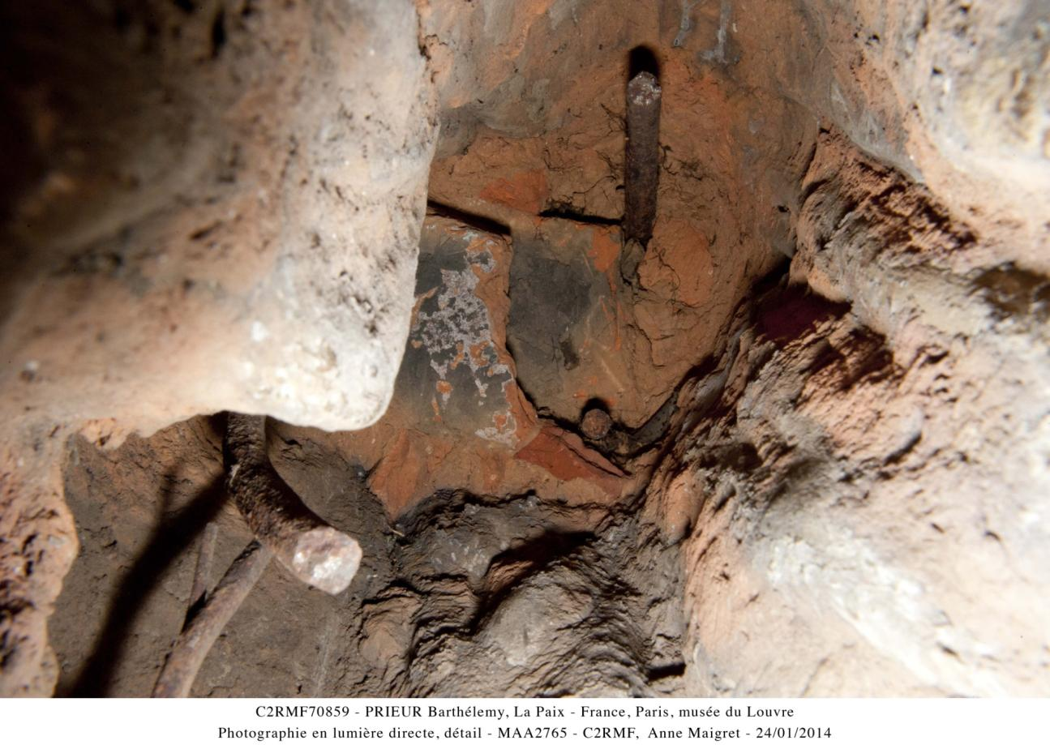
Visual evidence of lost wax casting
Fig 582
Clear traces of working in the wax can be found, for instance, in the modeling of details such as the vine leaf and grapes held by Abundance. It is also clear from the examination of the underside of all three sculptures, which are hollow casts with relatively thick, uneven metal walls, still partially filled with the baked, sandy clay cores that were built around a system of iron armature rods, as seen here in the interior of Peace.
Main questions
Synopsis of technical parameters
Further questions
Further Resources
Intro and context
Visual evidence
Lasagna
Alloys
Summary of findings...
Direct cast?
Armature
Core
Chaplets

Slide 5
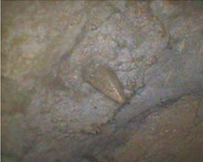
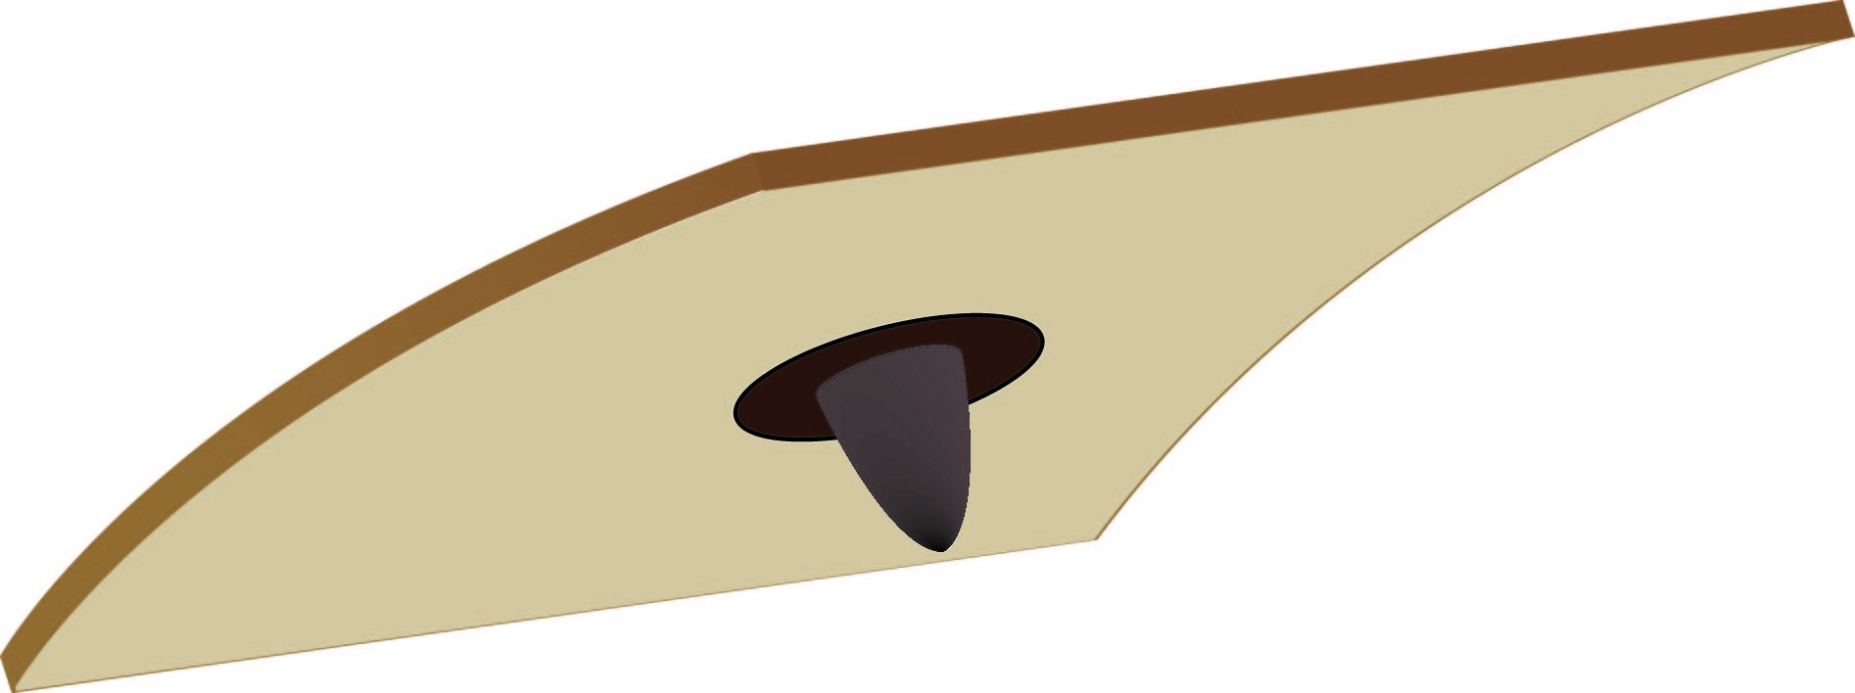
Securing core and investment:
Fig 581
Fig 583
The location of core supports is nearly invisible on the radiographs. Endoscopic examination of the interior metal walls of the Justice and the Peace where the core has been removed revealed a rather unique feature in both: the raised outline of what looks like a rectangular bronze patch with an integral faceted tapering point extending out from their center. That these features are idiosyncratic to these 2 casts is a strong indication of their production in the same foundry. No such chaplets could be observed in the radiographs of the Abundance due to the possible masking of the internal surface by the core.
Main questions
Synopsis of technical parameters
Further questions
Further Resources
Intro and context
Visual evidence
Lasagna
Alloys
Summary of findings...
Direct cast?
Armature
Core
Chaplets

Slide 6
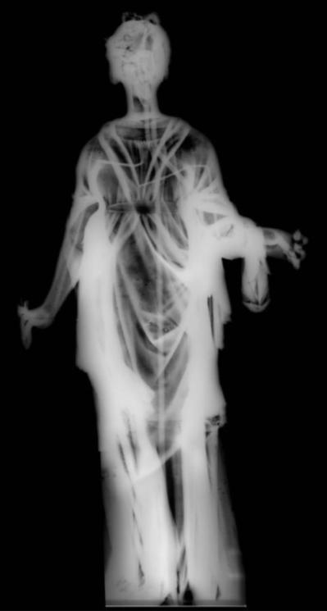

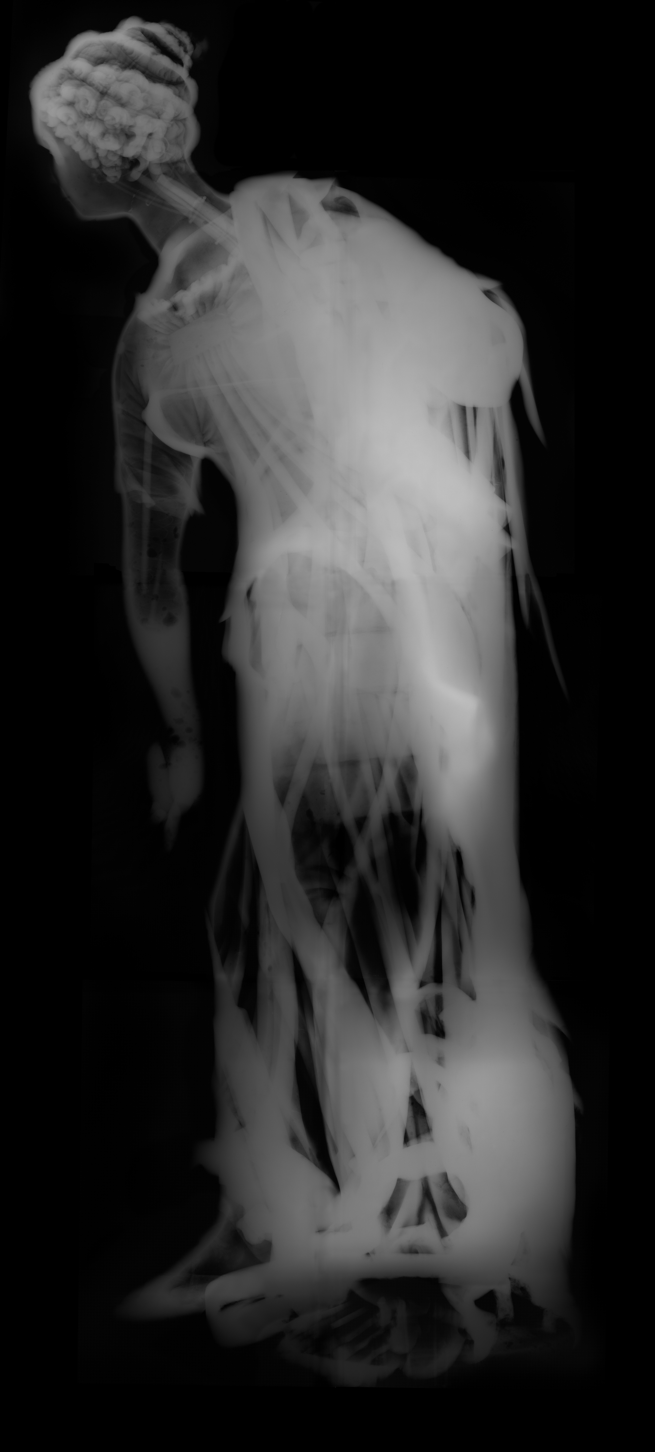
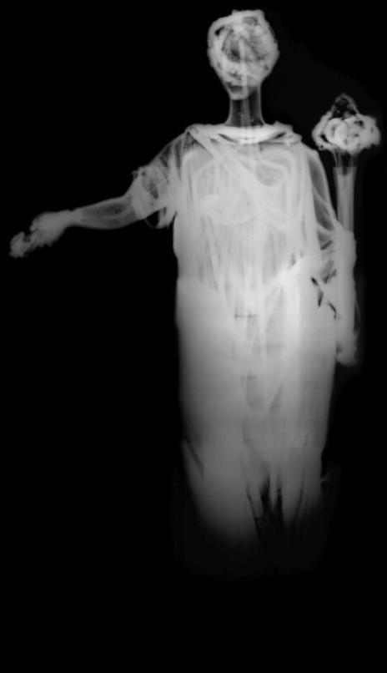

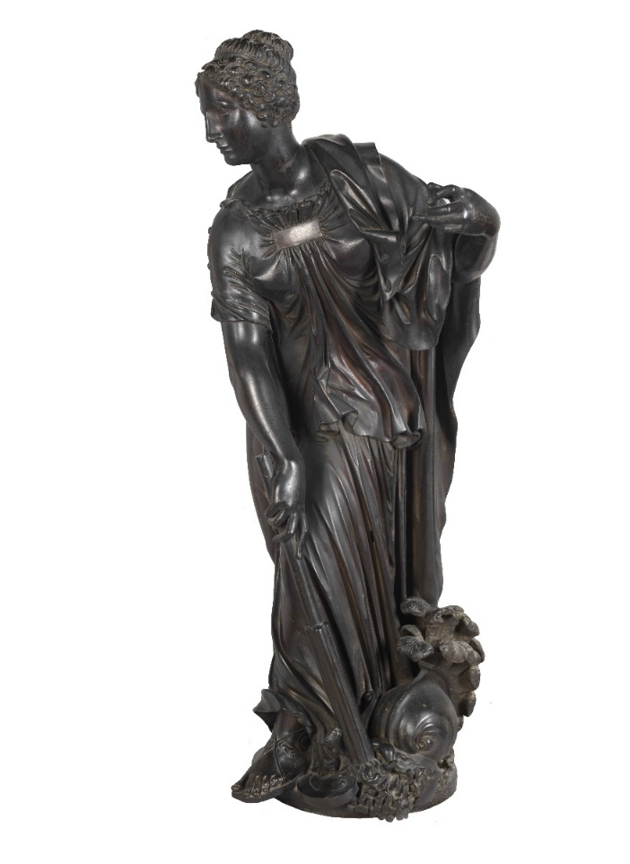
A direct lost wax cast?
Radiography of the statues shows the relatively thick metal walls and the shape of the preserved vestiges of the original armatures. Few wax-to-wax joints are visible, and the internal surfaces do not conform to external contours. The latter features suggested that the sculptures were directly cast.
Fig 540
Fig 546
Fig 542
Main questions
Synopsis of technical parameters
Further questions
Further Resources
Intro and context
Visual evidence
Lasagna
Alloys
Summary of findings...
Direct cast?
Armature
Core
Chaplets

Slide 7
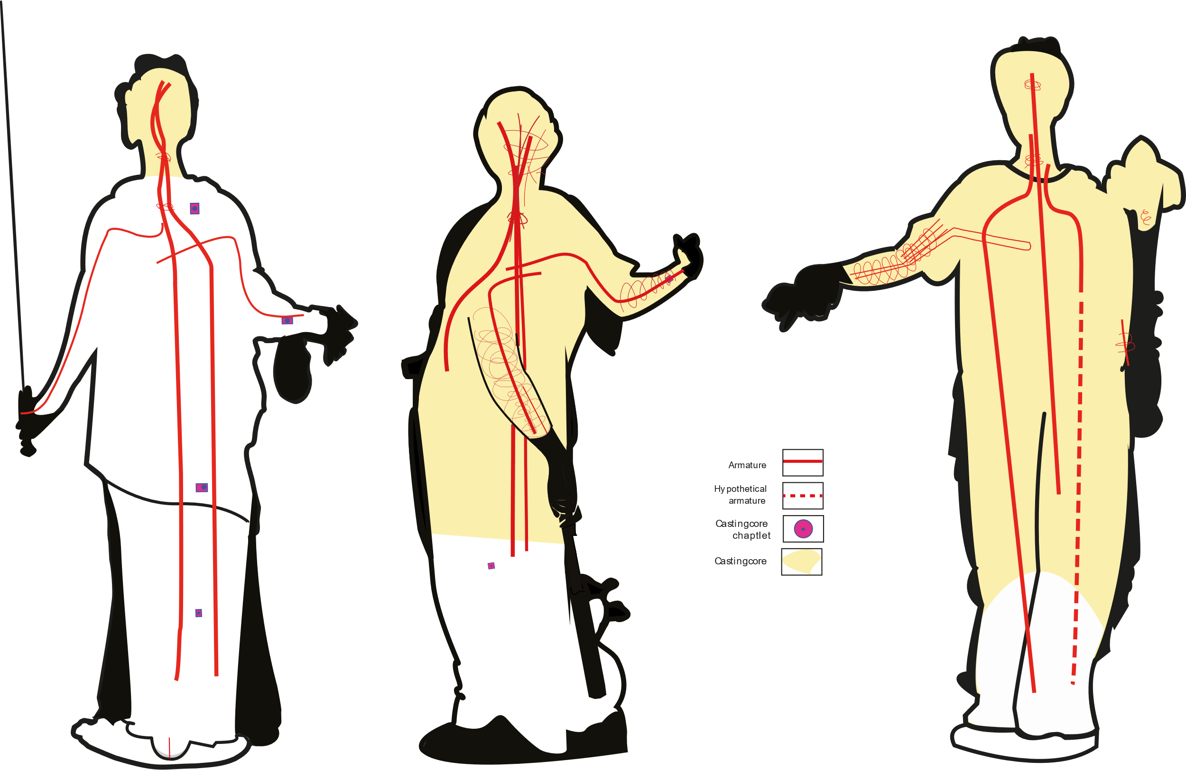
The armature systems:
Fig 540
Fig 546
Fig 542
The armature systems were mapped out based on the radiographs for each sculpture, to the extent possible. The gauge of iron rods seems similar in all three. Both of Prieur’s figures show that the core of the protruding arms was bound with wires. The Le Fort figure does not have these, probably because the core was almost entirely removed.
Main questions
Synopsis of technical parameters
Further questions
Further Resources
Intro and context
Visual evidence
Lasagna
Alloys
Summary of findings...
Direct cast?
Armature
Core
Chaplets

Slide 8
The lasagna process :
The surviving contract between Prieur and Peron, however, mentions that the founder produce the wax model from a plaster piece mold that the sculptor had made of his original model. All of the evidence now points to some version of the lasagna technique described by Benvenuto Cellini.
Fig 489
Abondance, 1571, Barthélémy Prieur, 128cm
© C2RMF A Maigret
Main questions
Synopsis of technical parameters
Further questions
Further Resources
Intro and context
Visual evidence
Lasagna
Alloys
Summary of findings...
Direct cast?
Armature
Core
Chaplets

Slide 9
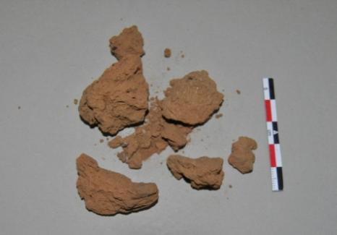
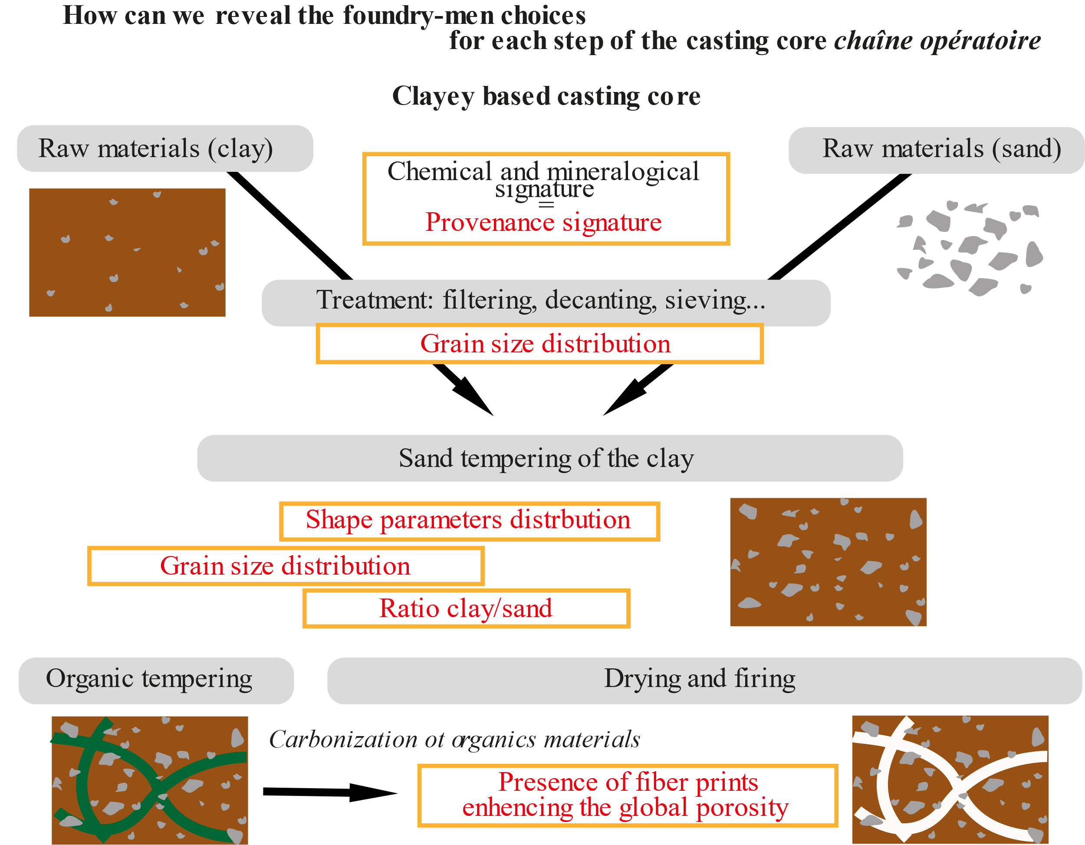
A characteristic core composition?
Fig 241
Fig 679
Some core could be sampled from underneath of each statue. A new methodology based on the precise measurement of the size of the quarts inclusions in the clay core of bronze statues has allowed to show that the cores of the 3 allegories were not only the same, but very specific with respect to 16th and 17th-century Parisian bronzes analyzed to date.
Main questions
Synopsis of technical parameters
Further questions
Further Resources
Intro and context
Visual evidence
Lasagna
Alloys
Summary of findings...
Direct cast?
Armature
Core
Chaplets
Notes:
Sable = ossature du matériau argileux
Dégraissant organique = création d’un réseau de porosité indispensable pour la circulation des gaz lors de la coulée du métal

Slide 10
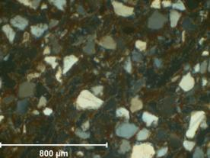
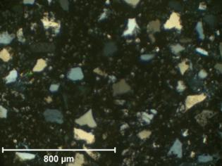
A characteristic core composition? (2)
Recipe1:
Uni-modal grain size distribution
Recipe2:
Bi-modal grain size distribution
Prieur’s core, recipe 1, contains a low quantity of sandy temper (32%) and a grain size of 70-220 µm. Prieur’s contemporaries used clay cores with a high quantity of Bi-modal sandy temper (33%) with grain sizes 70-270 µm. The variation in grain size is most significant on that part of the graph outlined in red.
Fig 572
Fig 573
Indeed, whereas the petrographic images do not show much differences, the distribution of sizes of quartz inclusions show slight but clear differences. Whereas in most 16th-17th-century Parisian bronzes, 2 sizes of inclusions coexist (very small inclusions of around 5 µm and much larger ones – 150µm), in the allegories only the large inclusions are present (100-200µm).
Main questions
Synopsis of technical parameters
Further questions
Further Resources
Intro and context
Visual evidence
Lasagna
Alloys
Summary of findings...
Direct cast?
Armature
Core
Chaplets

Slide 11
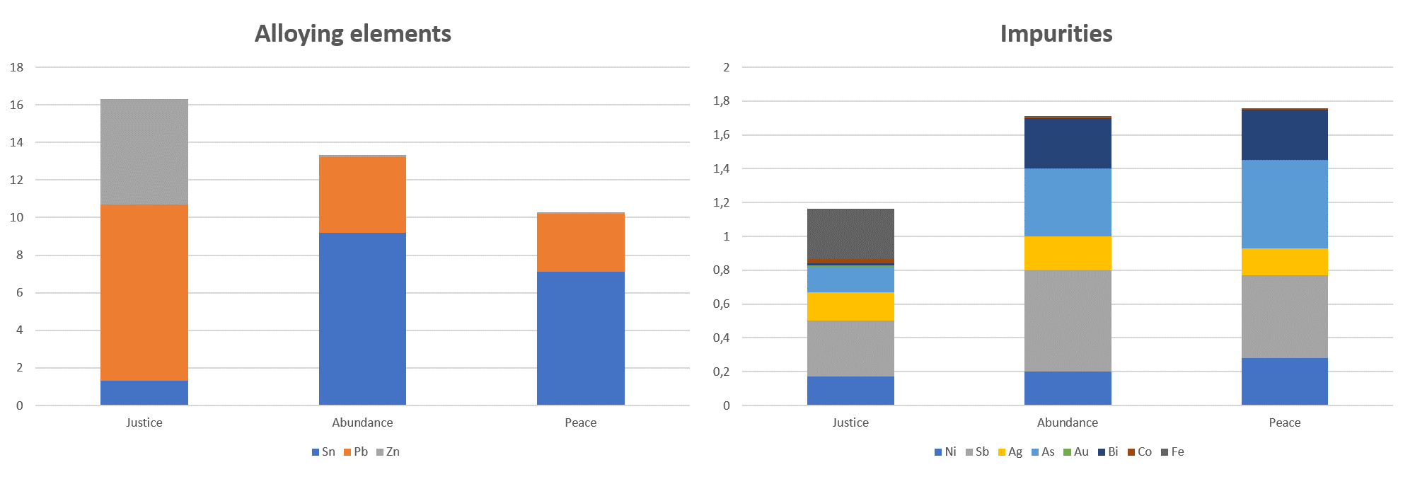
The alloys:
Fig 594
Abondance & Paix : same impurity pattern with High As and Sb
Abondance & Paix : tin bronze
Justice : leaded brass
Justice : specific pattern with high Fe and Bi
2 different alloys
2 different copper sources
ICP-AES analysis of a sample drilled from each statue revealed that Prieur’s Abundance and Peace are made of tin-bronze, whereas Le Fort’s Justice is made of brass. Moreover, the very different impurity patterns suggest disparate copper ore sources. If Péron cast all three sculptures, he would have been responsible for preparing and pouring the metal. How then to explain the variation in the alloy types?
Main questions
Synopsis of technical parameters
Further questions
Further Resources
Intro and context
Visual evidence
Lasagna
Alloys
Summary of findings...
Direct cast?
Armature
Core
Chaplets

Slide 12

Summary of findings:
The three figures were cast by a similar method using idiosyncratic chaplets, and a similar core composition, which strongly suggests that they were cast by the same founder.
The variation in metal composition would suggest, however, that a different founder was involved. All of Prieur’s large bronzes cast in France we know of are made of tin –bronze. It is possible that he imposed his choice of alloy on the founder. Conversely, Martin Le Fort was of less renown with no documented previous experience in casting, he might have left it up to Péron to work with his preferred alloy, which we assume was brass (this of course is only an hypothesis, we unfortunately have no record of other productions of Nicolas Péron to discuss this point). “
In the end, the sculptors’ different backgrounds and status allows us to rationalize that the alloy used for Prieur’s two figures was due to the artist’s deliberate Italianate choice, and that the founder Péron was willing and able to successfully execute the casts for the monument in both alloys.
Main questions
Synopsis of technical parameters
Further questions
Further Resources
Intro and context
Visual evidence
Lasagna
Alloys
Summary of findings...
Direct cast?
Armature
Core
Chaplets

Slide 13
Synopsis of technical study parameters:
The study was integrally carried out at the C2RMF as a public service to French museums. The total duration of the study was more than 100 person-days, as part of Manon Castelle’s PhD research.
Visual examinations: Several days were spent examining the statues with naked eyes.
Day-light photography: The photographs were done at the C2RMF studios using various cameras and lenses. It took circa 2 days to photograph one statue. Some 100 photos were taken per statue, circa 40 photos were selected. 4 more days were needed to process the digital images of one statue.
X-ray Radiography: All the X-ray radiographies were done at the C2RMF. The particularly large thickness of the metal wall and the core filling created a very dense barrier that pushed the X-ray facilities of the C2RMF to their limit (420 kv, several tenth of minutres exposure). Gammagraphy were almost necessary. It took circa 2 days to radiograph one statue, and 4 more days to scan the films and further process the digital images
Endoscopy: Visual inspection of the interior has been carried out by an industrial endoscope at the C2RMF. Half a day was necessary to inspect each statue. Unfortunately the apparatus does not allow to make photos with sufficient resolution for publication.
Bulk metal analyses by Atomic Emission spectrometry (ICP-AES): Circa 20 mg of metal was drilled in the wall of each statue, at the base, once they were removed from their pedestal (HSS steel drills, 1 mm diameter, 10 mm deep). Sampling is then rapid, 15 minutes per statue. For the analysis..... For more, see case study Java.
Core analysis: In the frame of Manon Castelle’s PhD, this study has been the opportunity to develop a new protocol. It is detailed in volume 2 chapter 7 (cores). Sampling is rapid, 1 hour per statue (but the statue needed to lay down). Thin section preparation is time-consuming as are observations of thin-section under optical microscope.
Main questions
Synopsis of technical parameters
Further questions
Further Resources
Intro and context
Visual evidence
Lasagna
Alloys
Summary of findings...
Direct cast?
Armature
Core
Chaplets
(Monument de cœur du connétable Anne de Montmorency© F Bewer)
13

Slide 14
Further questions
What was the original patina of the statues? Was it the same for all three?
What was Nicolas Peron’s training and production prior to the casting of the allegories?
With such information, it might provide insight into his alloy preference and approach to casting sculpture.
Main questions
Synopsis of technical parameters
Further questions
Further Resources
Intro and context
Visual evidence
Lasagna
Alloys
Summary of findings...
Direct cast?
Armature
Core
Chaplets
14

Slide 15
Further resources:
Bewer, F.G., D. Bourgarit, and J. Bassett. “Les Bronzes Français (XVIe-XVIIIe Siècle) : Notes Techniques.” In Bronzes Français de La Renaissance Au Siècle Des Lumières, Musée du Louvre-Somogy., 28–41. Paris: Bresc G. & Scherf G., 2008.
Bresc-Bautier, Geneviève, and Guilhem Scherf, eds. Bronzes Français de La Renaissance Au Siècle Des Lumières. Paris: Musée du Louvre; Somogy, 2008.
Castelle, M. “Les Techniques de La Fabrication de La Grande Statuaire En Bronze Entre 1540 et 1660 En France.”unpublished PhD. Université de Versailles - Saint Quentin, 2016.
Castelle, M., D. Bourgarit, and F. G. Bewer. “The Lasagna Method for Lost Wax Casting of Large 16th-Century Bronzes: Searching for the Sources.” In Cuivre, Bronzes et Laitons Médiévaux : Histoire, Archéologie et Archéométrie Des Productions En Laiton, Bronze et Autres Alliages à Base de Cuivre Dans l’Europe Médiévale (12e-16e Siècles). Medieval Copper, Bronze and Brass: History, Archaeology and Archaeometry of the Production of Brass, Bronze and Other Copper Alloy Objects in Medieval Europe (12th-16th Centuries), edited by N. Thomas and P. Dandridge, 297‑308. Études et Documents, Archéologie 39. Namur: Agence wallonne du Patrimoine, 2018.
Castelle, Manon, Yvan Coquinot, and David Bourgarit. “Casting Cores of French Bronze Statues of the 16th and 17th Centuries: Identification of Regional Practices and Artistic Choices.” Microchemical Journal 126 (2016): 121–31. https://doi.org/10.1016/j.microc.2015.11.032.
GRODECKI, C. Documents du Minutier central des notaires de Paris. Histoire de l'art au XVIème siècle (1540-1600), tome II : Sculpture, peinture et gravure, broderie, faïence et émaillerie, orfèvrerie et joaillerie, armes et armures., Archives nationales, 1986. p. 134 & 135
Seelig -Teuwen, R., D. Bourgarit, and F. Bewer. “Barthélemy Prieur Fondeur, Son Atelier, Ses Méthodes de Travail.” In French Bronze Sculpture: Materials and Techniques 16th - 18th Century, edited by D. Bourgarit, J. Bassett, F. G. Bewer, G. Bresc-Bautier, P. Malgouyres, and G. Scherf, 18–38. Paris: Archetype, 2014.
Main questions
Synopsis of technical parameters
Further questions
Further Resources
Intro and context
Visual evidence
Lasagna
Alloys
Summary of findings...
Direct cast?
Armature
Core
Chaplets
(Monument de cœur du connétable Anne de Montmorency© F Bewer)
15

